Slide 1
Decoupling Workflow From Forms
Using an Application Controller, IoC Container, Event Aggregator, and Command pattern
Presented By:
Derick Bailey
Copyright 2009 McLane Advanced Technologies, LLC

Slide 2

Topics Of This Presentation
Topics Covered
Workflow Services
Command Pattern
Event Aggregator
Application Controller
String It All Together With An IoC Container
Goals
Object Oriented System
Testability
Flexibility
Maintainability (Ease of Enhancement)

Slide 3
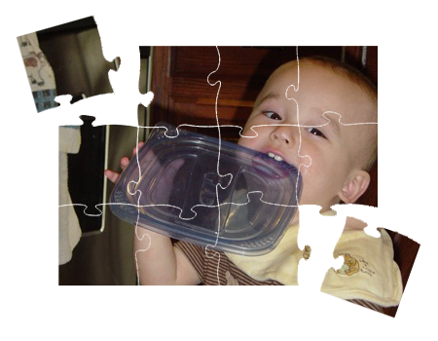
Object Oriented Principles
Cohesion:
“A measure of how strongly-related and focused the various responsibilities of a software module are” - Wikipedia

Slide 4
Object Oriented Principles
Encapsulation:
“The hiding of design decisions in a computer program that are most likely to change” - Wikipedia
?

Slide 5
Object Oriented Principles
Coupling:
“The degree to which each program module relies on each one of the other modules” – Wikipedia

Slide 6

Simple Org Chart
The Sample Application

Slide 7
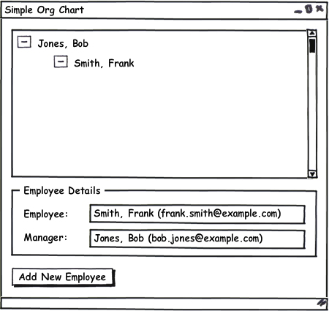
Simple Org Chart
The Main Form

Slide 8
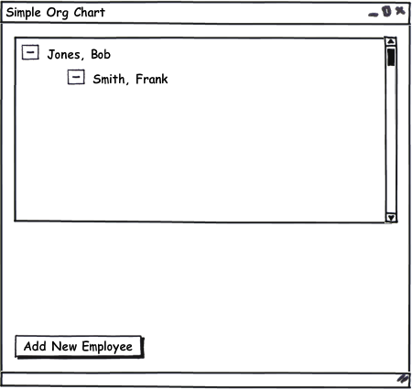
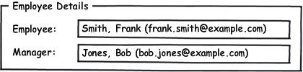
Simple Org Chart
The Main Form’s Parts

Slide 9
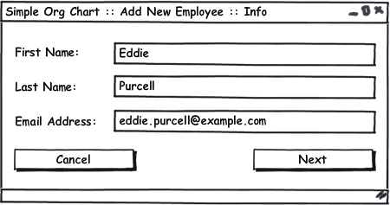
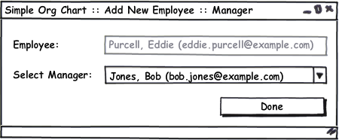
Simple Org Chart
Add New Employee Workflow

Slide 10
Simple Org Chart: Version 1
Tightly coupled forms: It works, but it doesn’t modify easily.

Slide 11
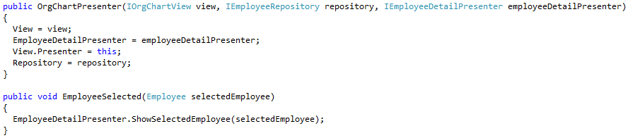
Simple Org Chart – v1
Tightly Coupled Presentation Logic: One Presenter Knows About Another

Slide 12
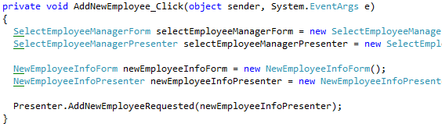
Simple Org Chart – v1
Tightly Coupled Workflow: Parent Form Knows About Children Forms, Presenters, and More!

Slide 13
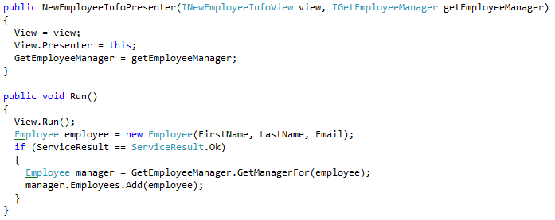
Simple Org Chart – v1
Tightly Coupled Workflow Logic: One Presenter Knows About Another

Slide 14
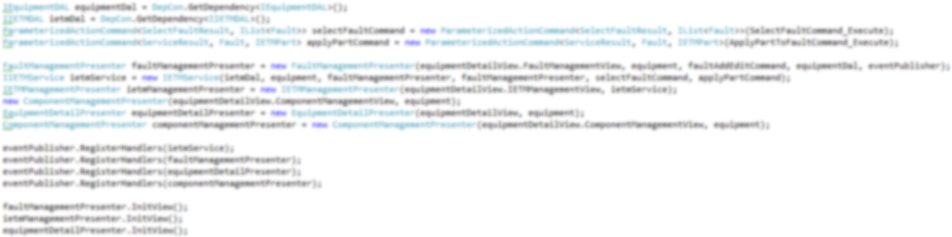

Simple Org Chart – v1
The Real World: How Bad The Coupling Can Get
1 Button
=
1 Button
=
1 Button
=
1 Button
=

Slide 15
Simple Org Chart Version 2
Introducing A Workflow Service

Slide 16

Workflow Services
Current Workflow: Add New Employee

Slide 17
Workflow Services
Decouple The Workflow Between Forms By Introducing A Service To Coordinate Them
Step 1
Workflow
Service
Step 2

Slide 18
Simple Org Chart Version 3
Introducing The Command Pattern

Slide 19
The Command Pattern
The command pattern is “used to represent and encapsulate all the information needed to call a method at a later time.” - Wikipedia
Invoked
Command
Invoker

Slide 20
The Command Pattern
Different Command Implementations In .NET
Delegates
Objects & Interfaces
Commands
Lambda Expressions
Anonymous Delegates

Slide 21
Simple Org Chart – v2
Decoupling The Add New Employee Workflow From The Main Form
(Insert Command Interface And Object, Here)

Slide 22


Simple Org Chart – v2
Add New Employee With ICommand
OrgChartPresenter

Slide 23
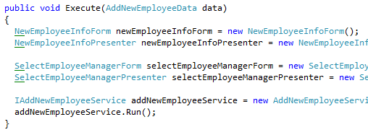
Simple Org Chart – v2
Add New Employee Command

Slide 24
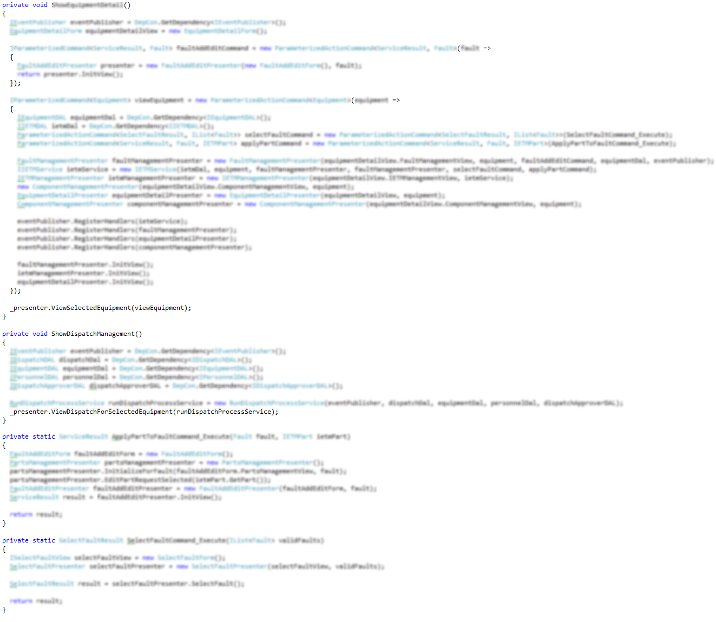

Pulling Dependencies Up
The Real World: Coupling Within ICommand Can Still Be Scary

Slide 25
Simple Org Chart Version 4
Introducing An Event Aggregator

Slide 26
Event Aggregator
“An Event Aggregator acts as a single source of events for many objects. It registers for all the events of the many objects allowing clients to register with just the aggregator.” – Martin Fowler
Event 1
Event 2
Event 3
Event Raiser
Event Listener
Event Raiser
Event
Publisher
Event Listener
Event Raiser
Event Listener

Slide 27

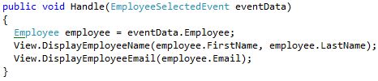
Event Aggregator
Publishing A Selected Employee
OrgChartPresenter

Slide 28
Dependency Inversion Issues
Passing Dependencies Down The Tree
IEventPublisher
That Object
An
Event Handler
Some Object
One More Object
This Object
An
Event Handler
Whatever Object
Another Object
Yet Another Object
An Event Publishing Object
An Event Publishing Object
An Event Publishing Object

Slide 29
Simple Org Chart – Final Version
Orchestration With An Application Controller And IoC Container

Slide 30
Dependency Injection
“The basic idea of … Dependency Injection is to have a separate object, an assembler, that populates a field … with an appropriate implementation for the … interface” – Martin Fowler
AnotherClass
ThisClass
IWhatever
ThatClass
IoC Container
ThatClass
IDoSomething
AnotherClass
IDoSomething
IWhatever
ThisClass

Slide 31
Application Controller
“Some applications contain a significant amount of logic about the screens to use at different points, which may involve invoking certain screens at certain times in an application.”
Model
View
Model
View
Model
View
Model
View
Presenter
Presenter
Presenter
Presenter
Workflow Service
Workflow Service
Application Controller
Event Aggregator
ICommand<T>
IoC Container

Slide 32
Additional Resources
Command Pattern
http://www.lostechies.com/blogs/derickbailey/archive/2008/11/19/ptom-command-and-conquer-your-ui-coupling-problems.aspx
Event Aggregator http://www.martinfowler.com/eaaDev/EventAggregator.html
StructureMap (IoC Container)
http://structuremap.sourceforge.net
Application Controller
http://www.martinfowler.com/eaaCatalog/applicationController.html

Slide 33
About Me… Derick Bailey
Sr. Software Engineer and Architect @ McLane Advanced Technologies
Blog: derickbailey.lostechies.com
Email: derick.bailey@mclaneat.com derick@derickbailey.com
Twitter: @derickbailey
www.mclaneat.com
McLane Advanced Technologies
4001 Central Pointe Parkway
Temple, Texas 76504
800-988-5428
Copyright 2008 McLane Advanced Technologies, LLC

